Slide 1
Working with JMS

Slide 2
What is JMS
JMS (Java Message Service) is an API that provides the facility to create, send and read messages. It provides loosely coupled, reliable and asynchronous communication.
MS is also known as a messaging service.
The Java Message Service (JMS) transport in WSO2 Micro Integrator allows you to easily send and receive messages to queues and topics of any JMS service that implements the JMS specification.

Slide 3
Why we need JMS
Generally, user sends message to application. But, if we want to send message from one application to another, we need to use JMS API.
Consider a scenario, one application A is running in INDIA and another application B is running in USA. To send message from A application to B, we need to use JMS.

Slide 4
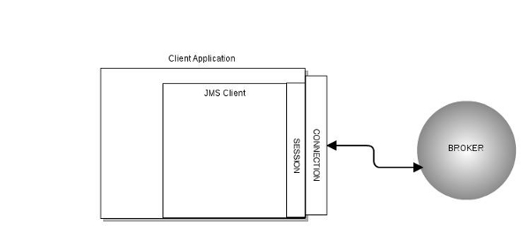
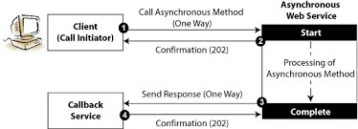
Advantage of JMS
1) Asynchronous: To receive the message, client is not required to send request. Message will arrive automatically to the client.
2) Reliable: It provides assurance that message is delivered.

Slide 5
Messaging Domains
Point-to-Point Messaging Domain
Publisher/Subscriber Messaging Domain

Slide 6

Point-to-Point (PTP) Messaging Domain
In PTP model, one message is delivered to one receiver only. Here, Queue is used as a message oriented middleware (MOM).
The Queue is responsible to hold the message until receiver is ready.
In PTP model, there is no timing dependency between sender and receiver.

Slide 7
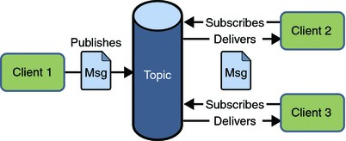
Publisher/Subscriber (Pub/Sub) Messaging Domain
In Pub/Sub model, one message is delivered to all the subscribers. It is like broadcasting. Here, Topic is used as a message oriented middleware that is responsible to hold and deliver messages.
In PTP model, there is timing dependency between publisher and subscriber.

Slide 8
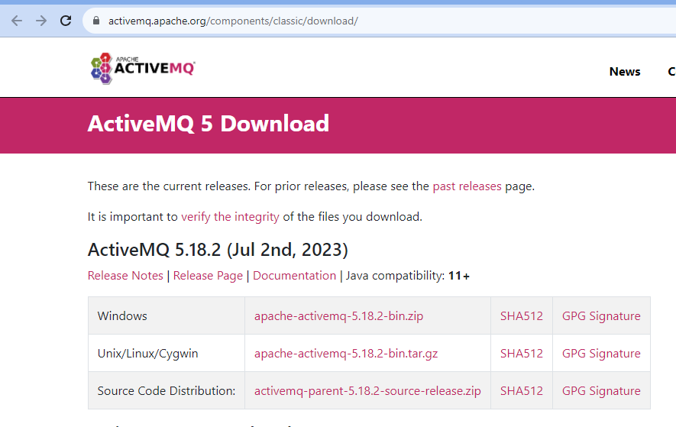
Download Active MQ and Configuration
Apache Active MQ can be downloaded from its Official site – https://activemq.apache.org/
Select the latest distribution. For a binary distribution, the filename will be similar to: activemq-x.x.x.zip.
Extract the files from the ZIP file into a directory of your choice.

Slide 9
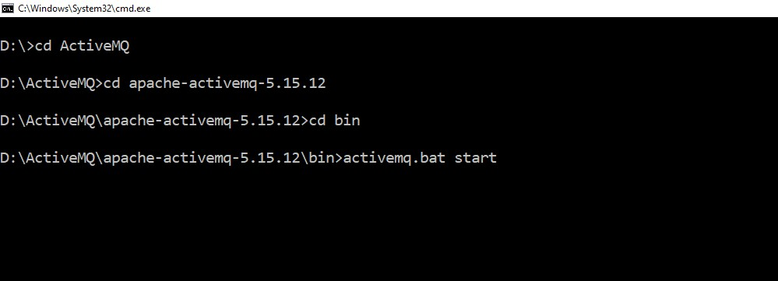
Run Active MQ
Enter Following command in CMD

Slide 10
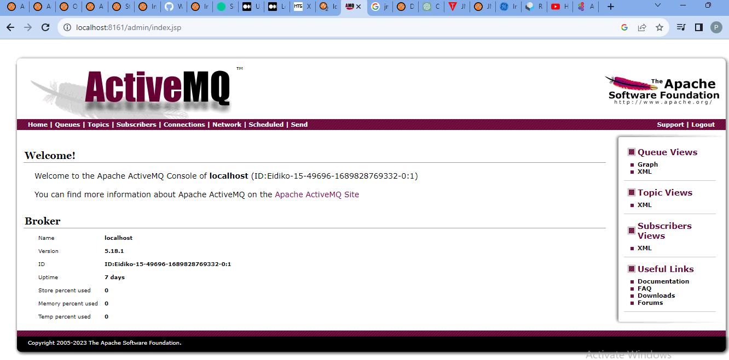
Monitoring ActiveMQ
You can monitor ActiveMQ using the Web Console by pointing your browser at
http://localhost:8161/admin

Slide 11
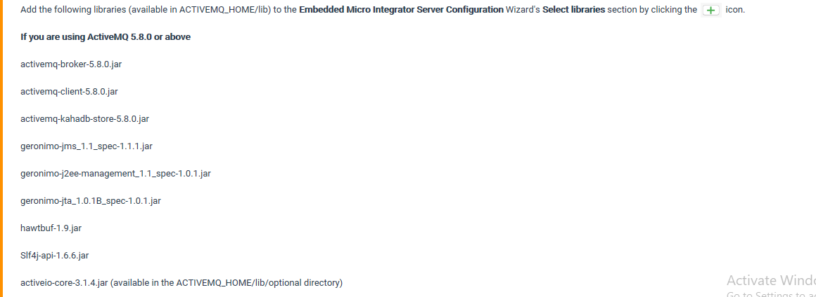
Active MQ setup in WSO2 for Publish Message
To configure the Kafka connector, copy the following client libraries from the <Active_HOME>/lib directory to the <ESB_HOME>/lib directory.

Slide 12
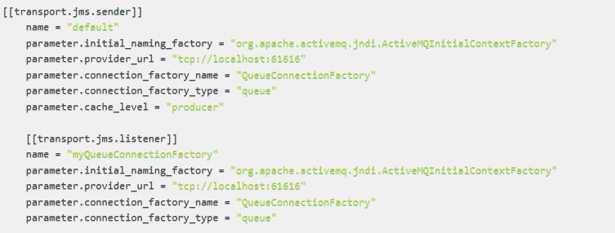
Active MQ setup in WSO2 for Publish Message
Select the Embedded Micro Integrator Server Configuration Wizard from the tool bar and add the following config to the Edit embedded deployment.toml file section to enable the ActiveMQ sender and listener transport.

Slide 13
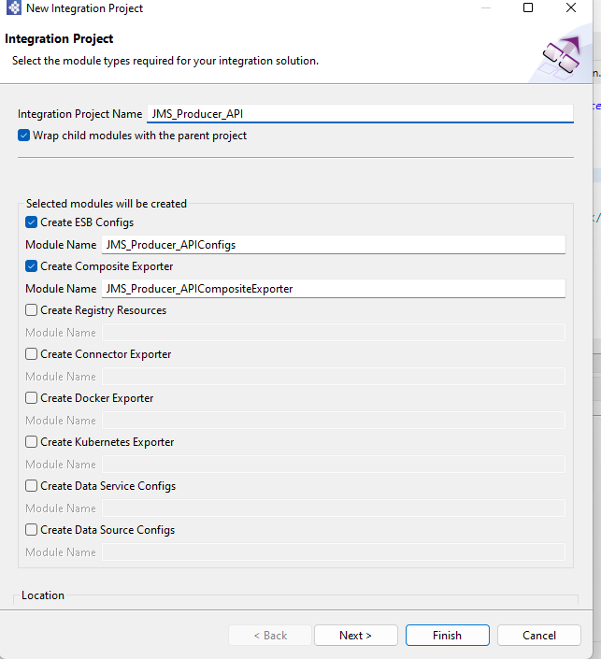
Active MQ setup in WSO2 for Publish Message
Create Integration project and select ESB config, Composite Exporter and Connector Exporter.

Slide 14
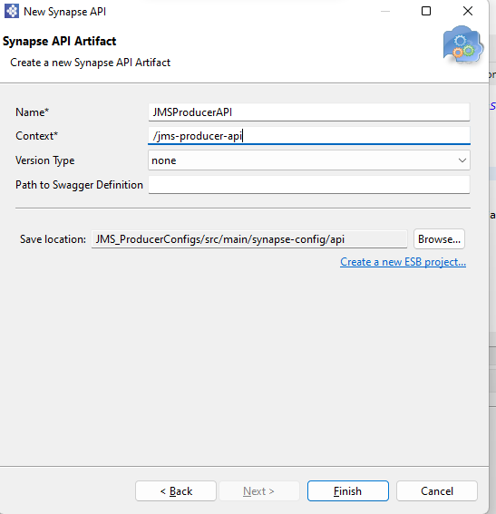
Active MQ setup in WSO2 for Publish Message
Right click on API artefact in ESB Config and click new, select REST API.
Enter Name and context of API and click on next

Slide 15
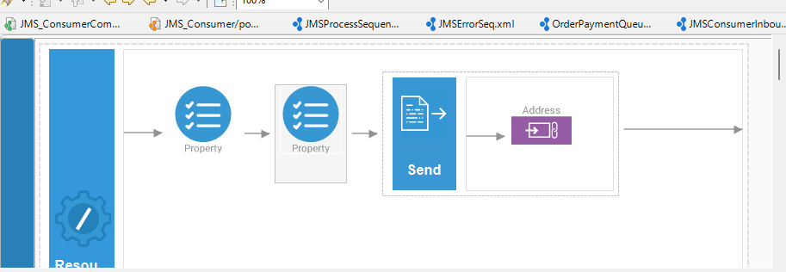
Active MQ setup in WSO2 for Publish Message
From the Mediator palette, click and drag a Two Property and send Mediator to the In sequence.
From the Endpoints palette, click and drag Address Endpoint to the In sequence.

Slide 16
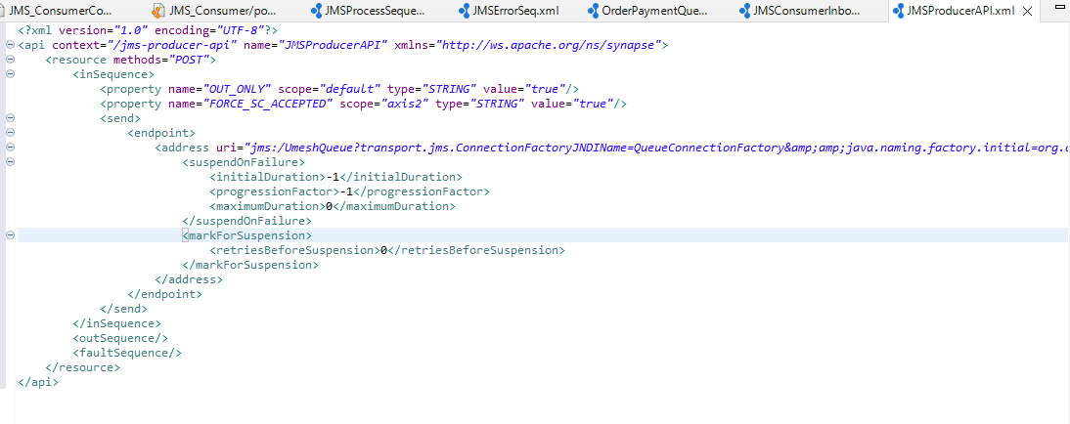
Active MQ setup in WSO2 for Publish Message
Enter following details.
First property select name OUT_ONLY and give value true.
First property select name FORCE_SC_ACCEPTED and give value true.
Enter following uri of endpoint
jms:/UmeshQueue?transport.jms.ConnectionFactoryJNDIName=QueueConnectionFactory&amp;amp;java.naming.factory.initial=org.apache.activemq.jndi.ActiveMQInitialContextFactory&amp;amp;java.naming.provider.url=tcp://localhost:61616&amp;amp;transport.jms.DestinationType=queue

Slide 17
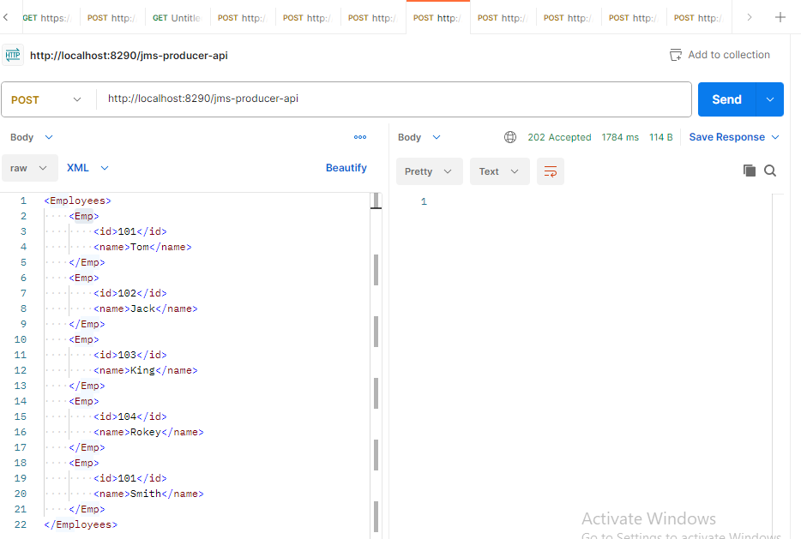
Test in Postman
Right click on the Project and configure the artifacts to the composite exporter and run it.
Through Postman send the request.

Slide 18
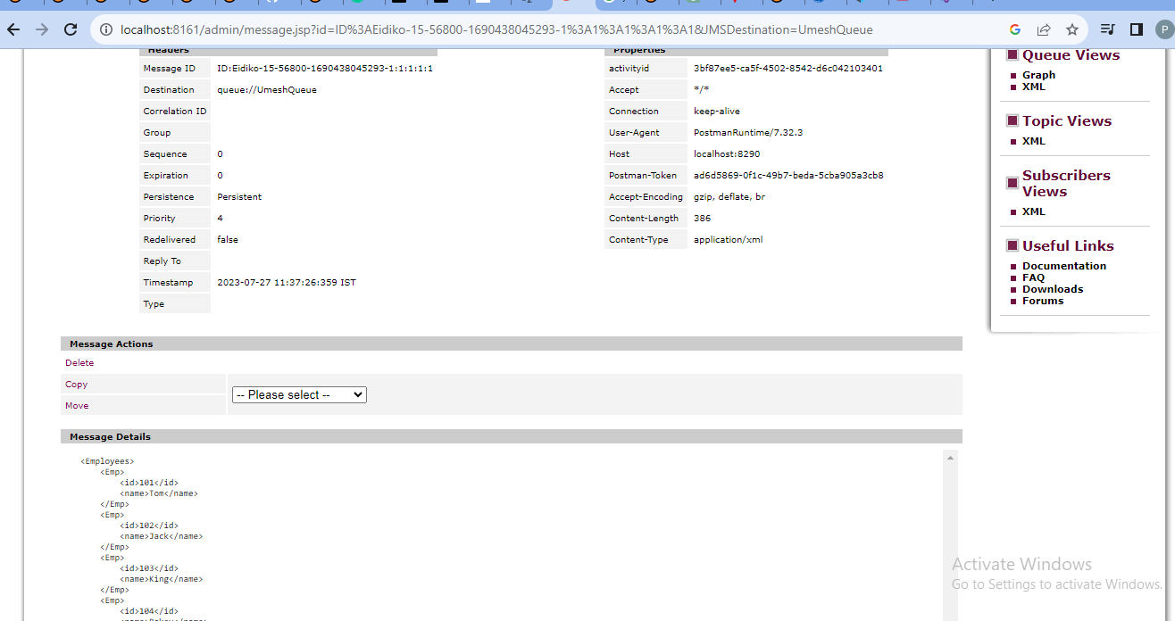
Test in Postman
Check message active MQ console

Slide 19
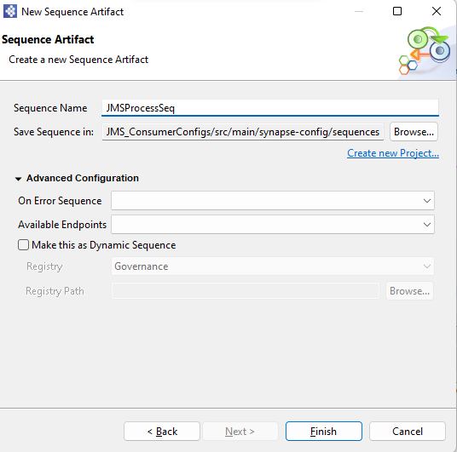
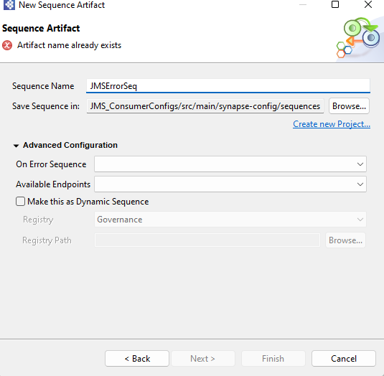
Active MQ setup in WSO2 for Subscribe Message
Right click on Sequence artefact in ESB Config and click new, select Sequence .
Enter Name of Sequence and click on next.

Slide 20
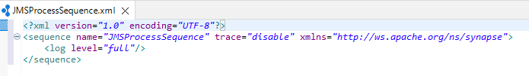
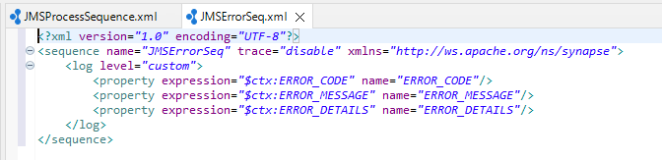
Active MQ setup in WSO2 for Subscribe Message
From the Mediator palette, click and drag log Mediator to the In both sequence.
In process sequence select log level full.
In error sequence add following properties.

Slide 21
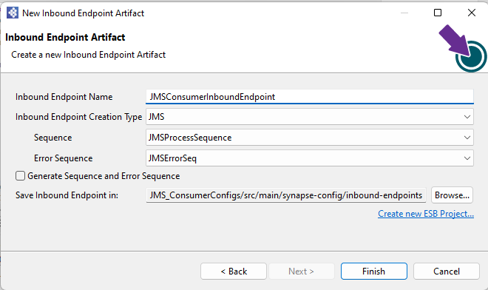
Active MQ setup in WSO2 for Subscribe Message
Right click on Inbound Endpoint artefact in ESB Config and click new, select Inbound Endpoint.
Enter Name of Inbound Endpoint and click on next.
Select type, process and error sequence.

Slide 22
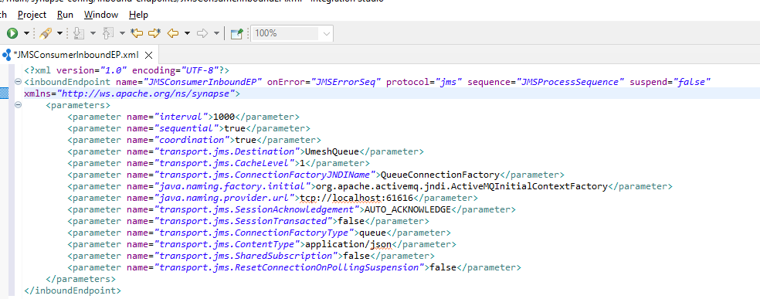
Active MQ setup in WSO2 for Subscribe Message
Enter Following parameter and click on save.

Slide 23
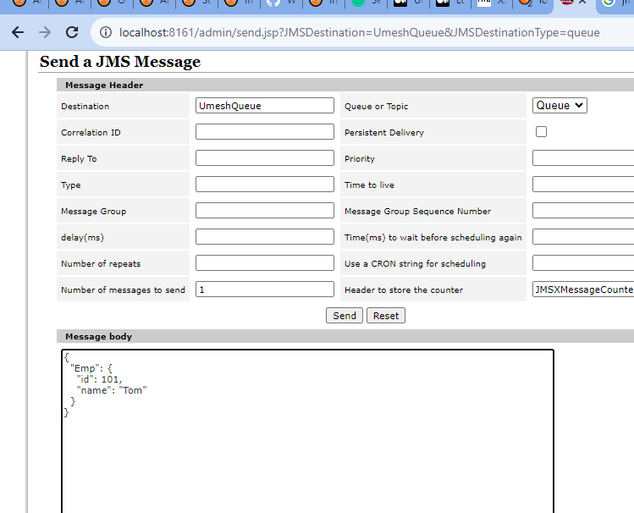
Test in Active MQ Queue
Right click on the Project and configure the artifacts to the composite exporter and run it.
Write the message in Active MQ Queue and Click on send.

Slide 24
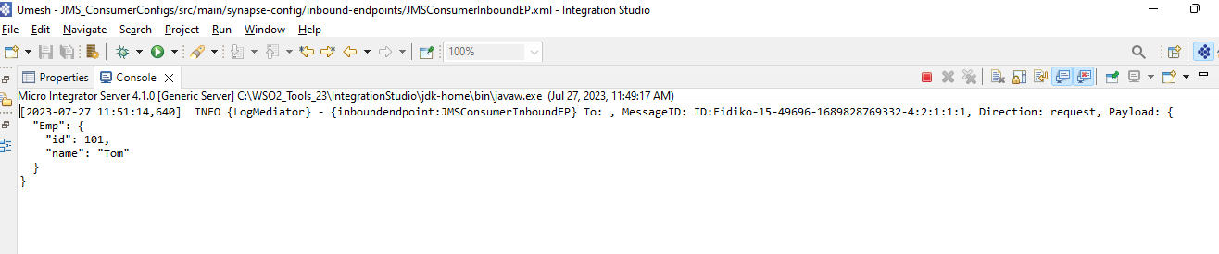
Test in Active MQ Queue
Check message in WSO2 Integration studio console

Slide 25


